Slide 1
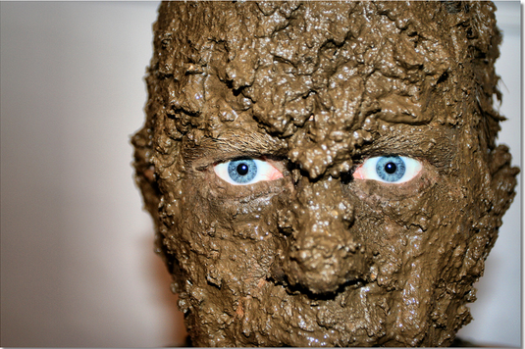
Project “Muddy” IST303 Group Project

Slide 2
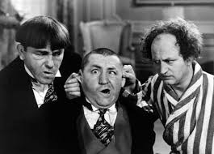
Our Software Development Team…
Ilya Mikhaltsou Project Leader Chief Programmer Ilya.Mikhaltsou@cgu.edu | Mark Kim Ambassador Business Analyst mark.kim@cgu.edu | David Kallemeyn Programing Team Leader Class Maintainer David.Kallemeyn@cgu.edu
Notes:
That used to be me.

Slide 3
Version Control, Builds and CI
Github, Travis, Appveyor
continuous builds
continuous testing
always know if you have working software

Slide 4
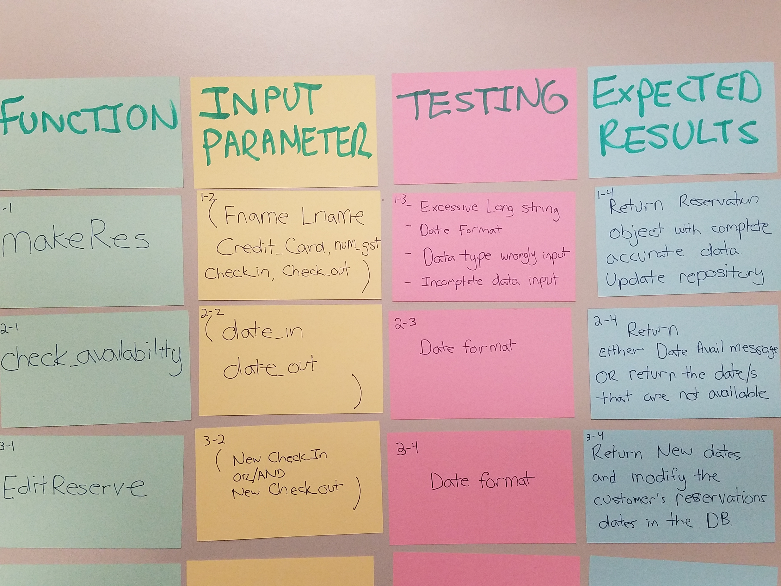
Testing, Testing, Testing, and more Testing
Timeline and Scheduling
Leveraging advantages of CI
immediately identify which changes broke functionality
Checkins resulting in broken software are highest priority
Keeps tests on green
Testing functions
Add bugs as tasks
Fix Bugs

Slide 5
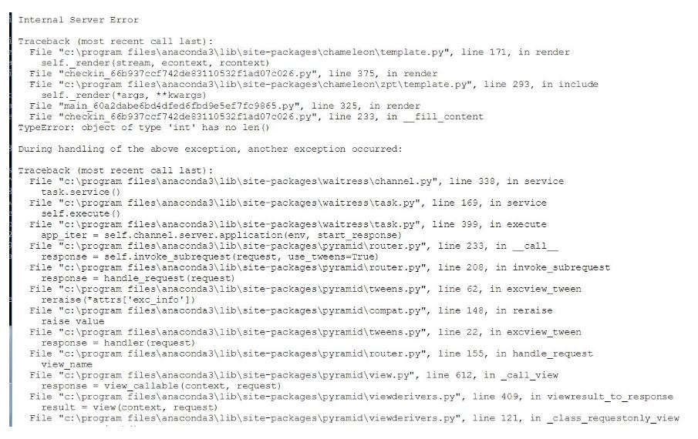
Testing Example
<- likely a method re-worked but did not change code calling the method

Slide 6
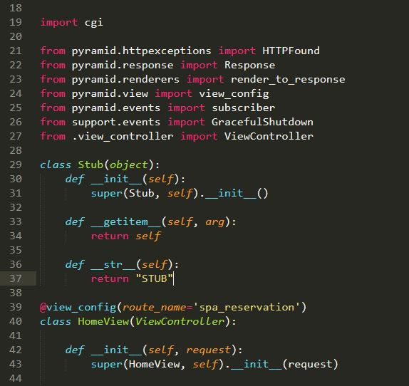
Using object stand-ins to test
STUB object used to pass values to function in Spa Reservation

Slide 7
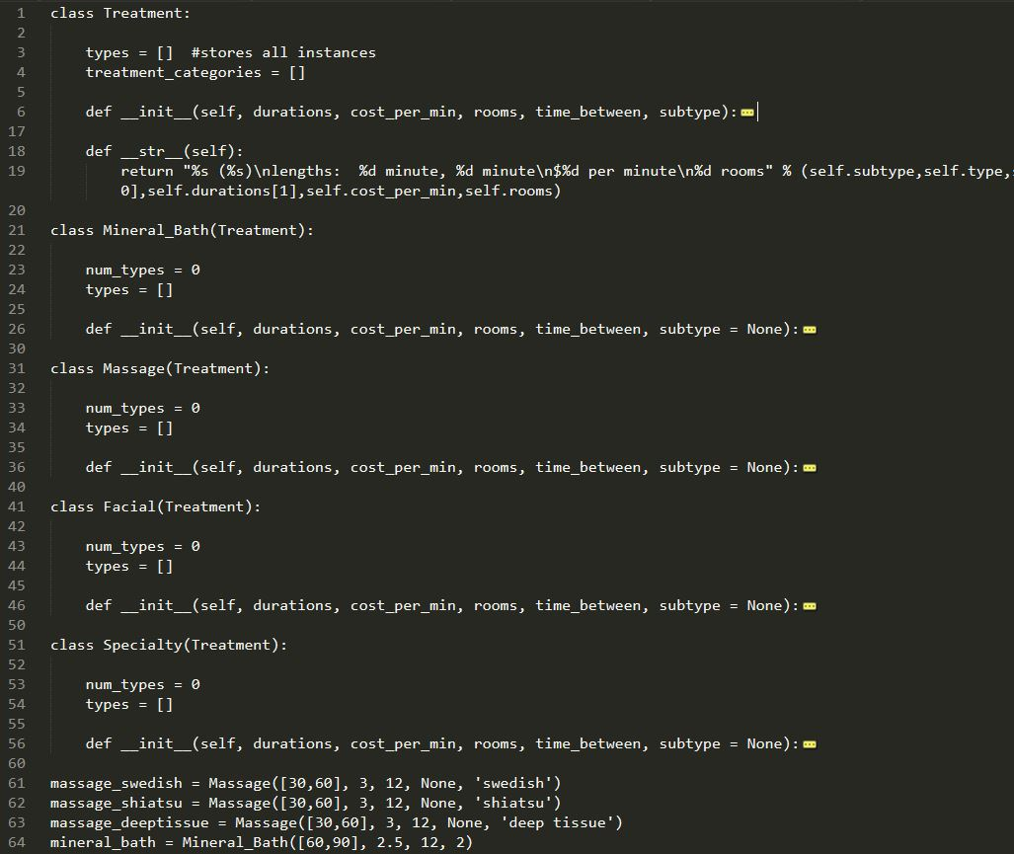
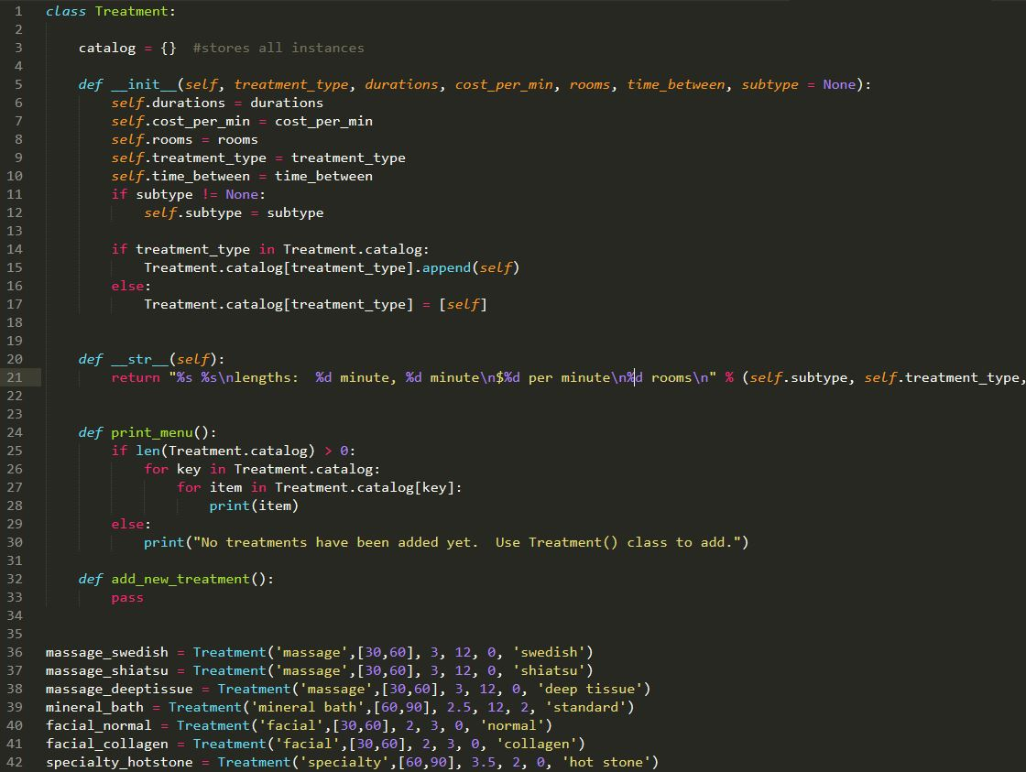
Refactoring: Treatment Types
BEFORE: Parent Treatment class with all types as subclasses
AFTER: A single treatment class, with types as instances

Slide 8
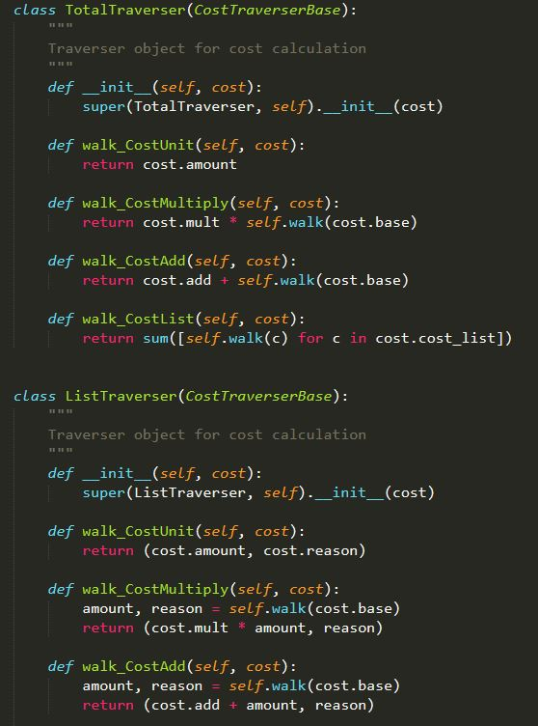
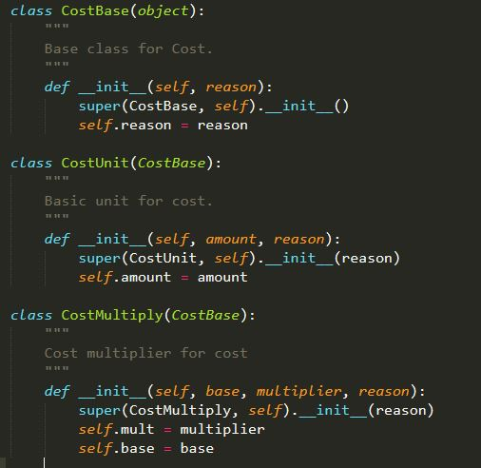
Refactoring: Cost Calculations
BEFORE (not pictured): Cost calculated in a method of reservation class
AFTER: Cost calculations abstracted to Cost objects and summed with traverser objects:
Easy to add cost calculation to any class
Prepare for future changes to code

Slide 9
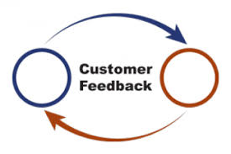
Remaining client-focused
Meet with client
Re-prioritize
Listen and ask more questions
Back to work - incorporate client changes

Slide 10
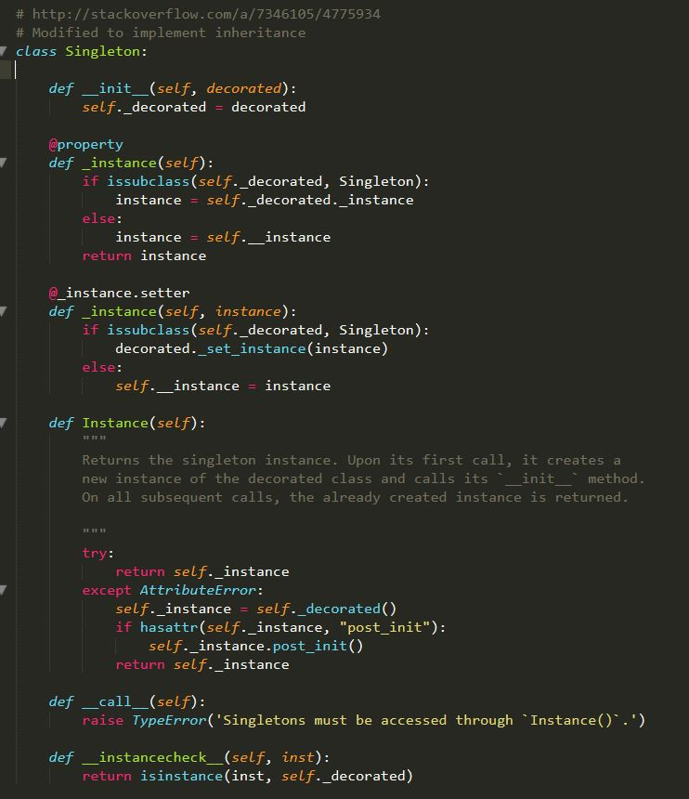
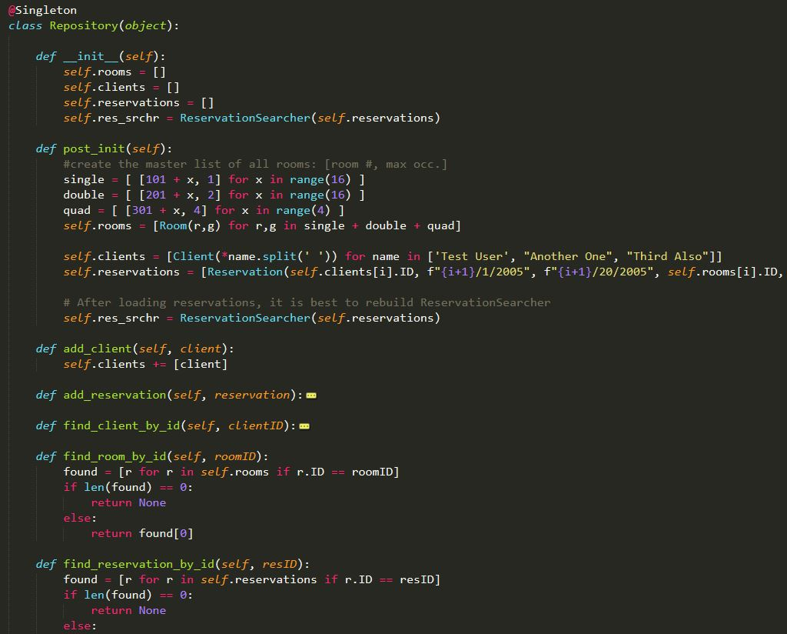
Under the “hood”: Repository
Singleton Design Pattern: one and only one instance allowed
Repository class as a singleton:
Searchable “database” object

Slide 11
Final Burn Down
Python 3.5-> 3.6 migration
Heavy refactoring
New UI Tools
Final Push

Slide 12

Lessons learned...
Highlights:
Over 42,000 lines of code
300+ commits
Several new tools and frameworks utilized
AGILE lessons:
Large differences in coding skill => high variance output
Refactoring is good, but can go overboard
Stick to essential functionality first

